Slide 1
Second Year Project II
By Shuvani Choudhury and Anh Tran

Slide 2
Question 1: Pre-processing
Methods Used:
One-Way Tabulation
N-Way Tabulation
Excel
Create new sheet by Specifying the Frequency/Range...
Results Found:
Clusters (1,1) = Lane 1
Clusters (1,6) = Lane 2

Slide 3
Question 2: Testing
Methods/Tests Used:
Estimate Equation (Least Squares)
Wald Test
Jarque Bera Test
---------------------------------------------------------
LM Test
Q-Test
Likelihood Ratio Test
Akaike Information Criterion (AIC)

Slide 4
Question 2: Testing (Contd.)
White Test
Estimate Equation (Robust Least Squares)
-------------------------------------------------------------------
Forecast
Results:
U(t) = 46.3948 + 0.3162*U(t-1) - 0.1287*U(t-2) + 0.1576*U(t-3) - 0.0046*U(t-4) - 0.1010*U(t-5) + 0.1251*U(t-6) + 0.1168*U(t-7) - 0.1118*U(t-8) + 0.0349*U(t-9) + 0.0078*U(t-10) - 0.0100*U(t-11) + 0.0798*U(t-12) - 0.1241*U(t-13) + 0.1038*U(t-14) - 0.0467*U(t-15) + 1.4942*(@WEEKDAY=2) - 21.4596*(@WEEKDAY=3) + 1.0064*(@WEEKDAY=4) - 20.0365*(@WEEKDAY=5)

Slide 5
Question 2: Testing (Contd.)
U(t) = 57.0012 - 0.0218*U(t-1) - 0.0357U(t- 2) + 0.0010*U(t-3) + 0.0438*U(t-4) + 0.0439U(t-5) + 2.2656*(@WEEKDAY=2) - 1.3117*(@WEEKDAY=3) + 0.9816*(@WEEKDAY=4) + 4.9891*(@WEEKDAY=5)
*V(t) = 57.2526 + 58.3742*(@WEEKDAY=2) - 4.1702*(@WEEKDAY=3) + 73.2439*(@WEEKDAY=4) - 20.1628*(@WEEKDAY=5)
*V(t) = 80.4066 + 11.2566*(@WEEKDAY=2) + 28.2842*(@WEEKDAY=3) + 2.3225*(@WEEKDAY=4) + 119.0351*(@WEEKDAY=5)
*W(t) = 3663.4284 - 619.9506*(@WEEKDAY=2) + 753.4660*(@WEEKDAY=3) - 18.6422*(@WEEKDAY=4) + 877.6078*(@WEEKDAY=5)
W(t) = 3908.2041 + 0.0918*W(t-1) - 0.1536*W(t-2) + 0.2163*W(t-3) - 0.0568*W(t-4) + 0.2710*W(t-5)

Slide 6
Question 3: Forecasts
Date | Number of Shipments (1) | Number of Shipments (2) | Gross Volume (1) | Gross Volume (2) | Gross Weight (1) | Gross Weight (2)
10/16/2017 | 76.1074 | 59.6025 | 57.2526 | 80.4066 | 3663.428 | 5695.253
10/17/2017 | 76.3347 | 66.9714 | 115.6268 | 91.6632 | 3043.478 | 5400.956
10/18/2017 | 51.3366 | 60.3709 | 53.0824 | 108.6907 | 4416.894 | 5898.426
10/19/2017 | 72.4791 | 61.3272 | 130.4965 | 82.7290 | 3644.786 | 5678.467
10/20/2017 | 59.7489 | 67.2448 | 37.0898 | 199.4417 | 4541.036 | 6020.416

Slide 7
Question 4-6:
PREPROCESSING
Aggregate the shipment data (weight, volume, number of shipments) for a given origin-destination pair.
Ignore pickup dates.
New dataset: 4011 shipments
Choose relevant variables: Origin Country, Origin City, OriginCluster, OriginClusterLat, OriginClusterLong, OriginLat, OriginLong, Dest Country, Dest City, DestinationCluster, DestinationClusterLat, DestinationClusterLong, DestLat DestLong, TR Gross Weight (KG), Nb of Ship Units, TR Gross Volume (M3)

Slide 8
Question 4: Performance of initial clustering
CLASSES
Shipment
Cluster
Location
ShipmentList
Clustering
Other classes
HaversineDistance

Slide 9
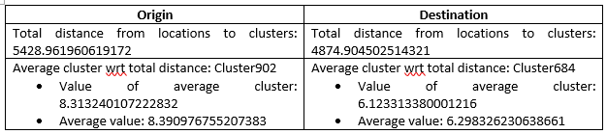
Question 4: Performance of initial clustering (Contd.)

Slide 10
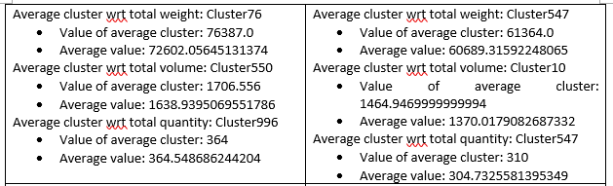
Question 4: Performance of initial clustering (Contd.)

Slide 11
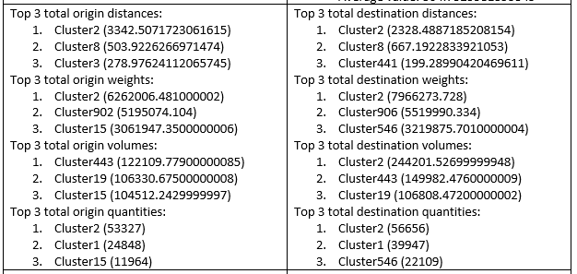
Question 4: Performance of initial clustering (Contd.)

Slide 12
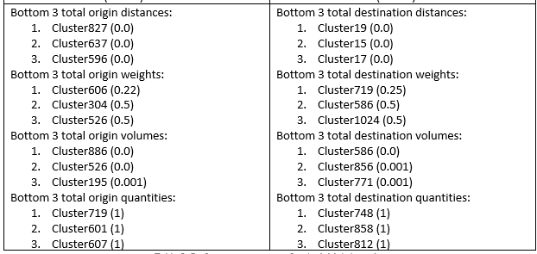
Question 4: Performance of initial clustering (Contd.)

Slide 13
Question 5: k-Means Clustering
HOW IT WORKS
Randomly assign shipments to k clusters (We did this sequentially).
Calculate location of cluster centroids
Assign shipments to nearest centroids
Repeat step 2-3 until the shipment assignment does not change
RESULTS FOR SEVERAL VALUES OF k
General not as good as those of the initial clustering.
Possible reason: Initial clustering is more holistic

Slide 14
Question 5: k-Means Clustering (Contd.)
K = 5:
Total distance from locations to clusters: 720861.7421654129
Total distance from locations to clusters: 911800.9561343524
Metrics are higher for this algorithm.
However, k-Means clustering gives a good general idea about the shipments.

Slide 15
Question 6: Alternatives
SEGMENTATION
Divide up the dataset by countries
Group 1: shipments whose origin & destinations are the same (country-specific)
Group 2: cross-border shipments
Perform k-Means Clustering on each data subset

Slide 16
Conclusion
Timeseries Analysis: statistical tests, forecasts
Cluster Analysis: metric evaluation, clustering algorithm
Improvements

